Slide 1
Symmetry, Even and Odd Functions
Notes: 9/11

Slide 2
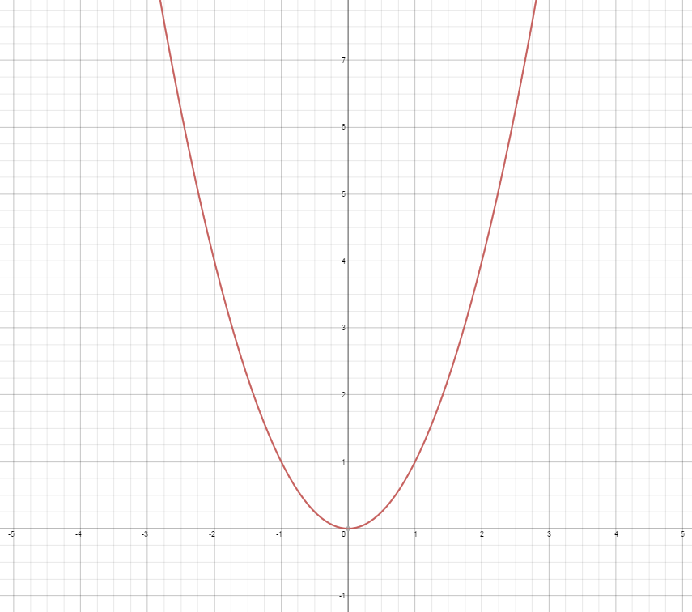
Symmetry, even and odd functions
A graph is symmetric if it can be reflected over a line and remain unchanged.
y = x²
is symmetric over the y-axis.
The y-axis is called the axis of symmetry.

Slide 3

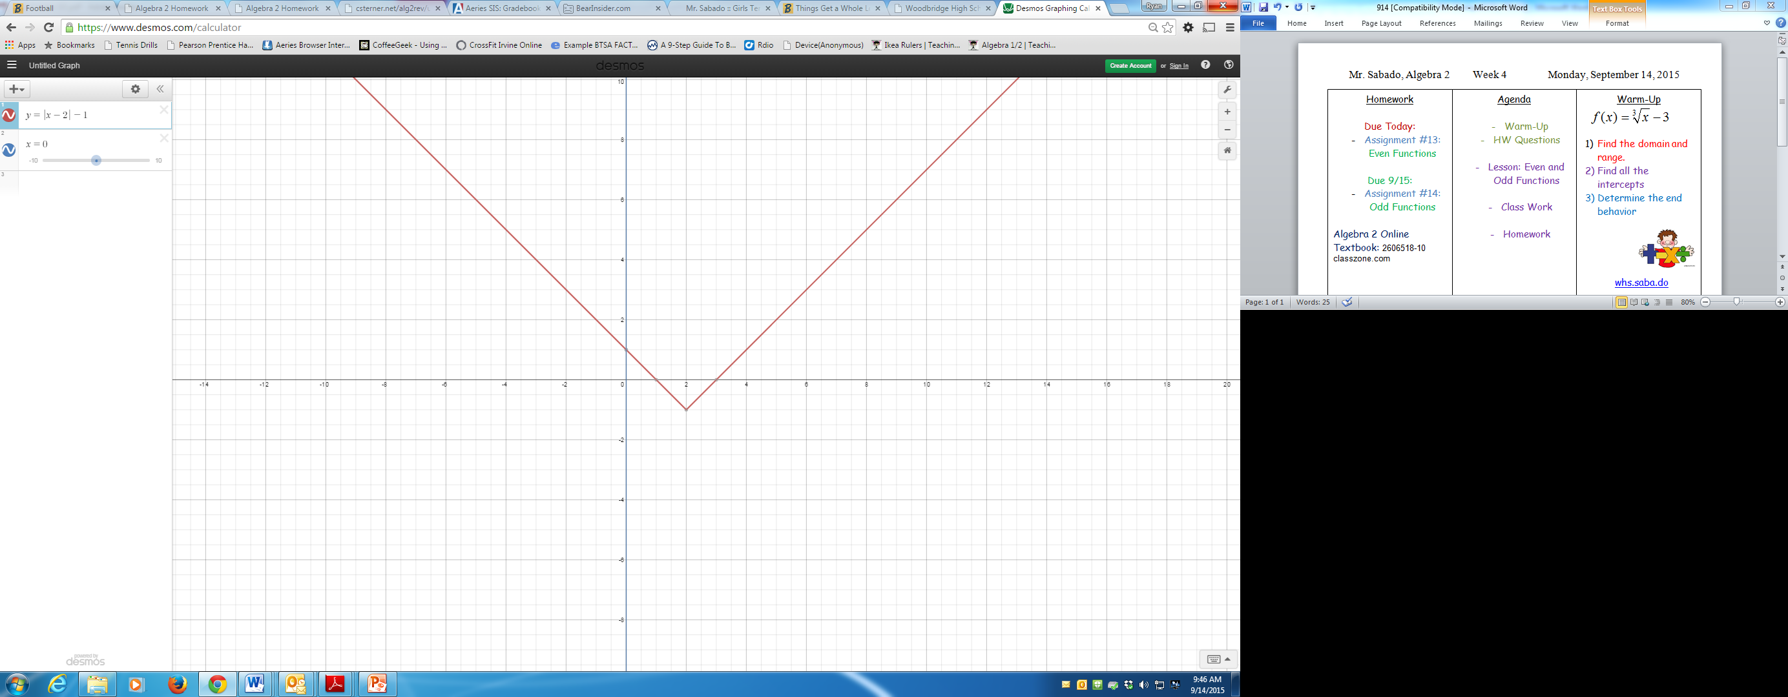
Symmetry, even and odd functions
A graph is symmetric if it can be reflected over a line and remain unchanged.
is symmetric over x = 2.
x = 2 is called the axis of symmetry.

Slide 4

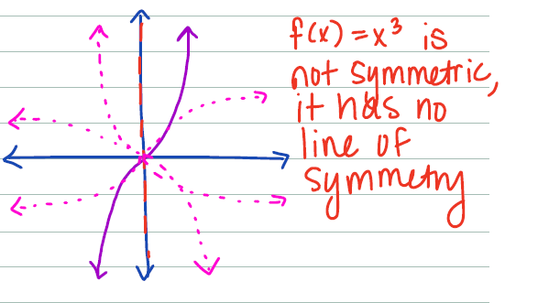
Symmetry, even and odd functions
A graph is symmetric if it can be reflected over a line and remain unchanged.

Slide 5
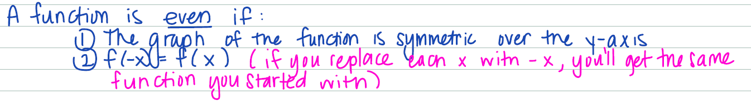
Even Functions

Slide 6
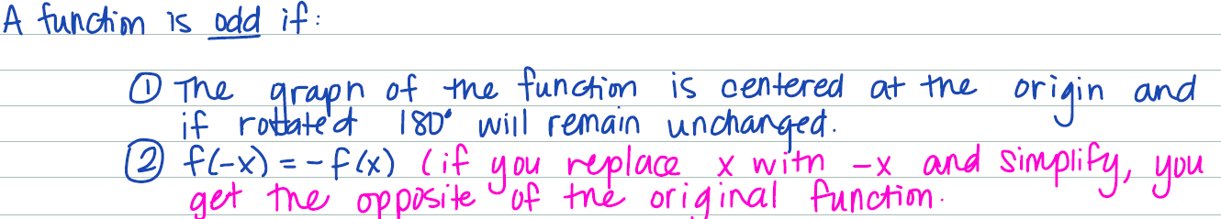
Odd Functions

Slide 7
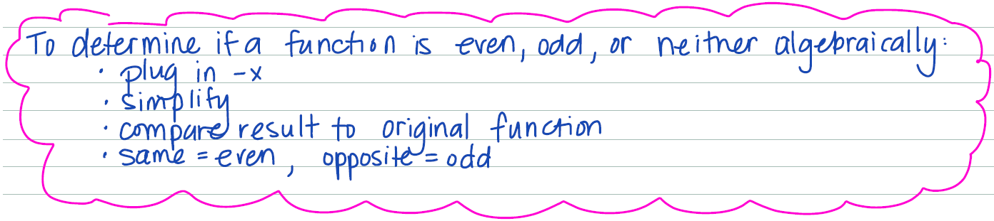
How to determine if it is even or odd?

Slide 8
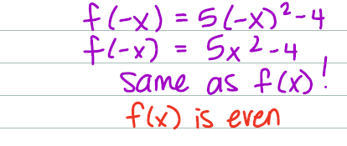
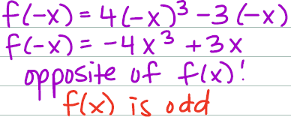
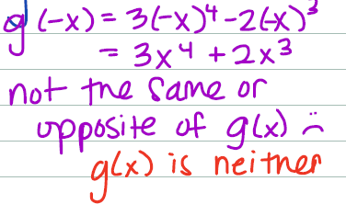
Your Turn…

